Slide 1
Spooky Author Identification
By Cristina Iacob

Slide 2
Goal
The aim of this project is to predict the author of some given paragraphs based on author’s writing style. In particular, we will be analyzing texts from Edgar Allan Poe, Mary Shelley, and HP Lovecraft.
Intended Audience
Anybody interested in an enhanced literature search tool to find the (most likely) author of a preferred piece, as well as other writers with similar literary style
Ex: an online bookstore which want to improve user’s experience, also resulting in increased sales

Slide 3
Data Description
The dataset contains text from works of fiction written by Edgar Allan Poe, HP Lovecraft and Mary Shelley.
File descriptions
train.csv - the training set - 19,579 samples
test.csv - the test set - 8,392 samples
Data fields
id - a unique identifier for each sentence
text - some text written by one of the authors
author - the author of the sentence (EAP: Edgar Allan Poe, HPL: H.P. Lovecraft; MWS: Mary Wollstonecraft Shelley)
Data source:
https://www.kaggle.com/c/spooky-author-identification

Slide 4
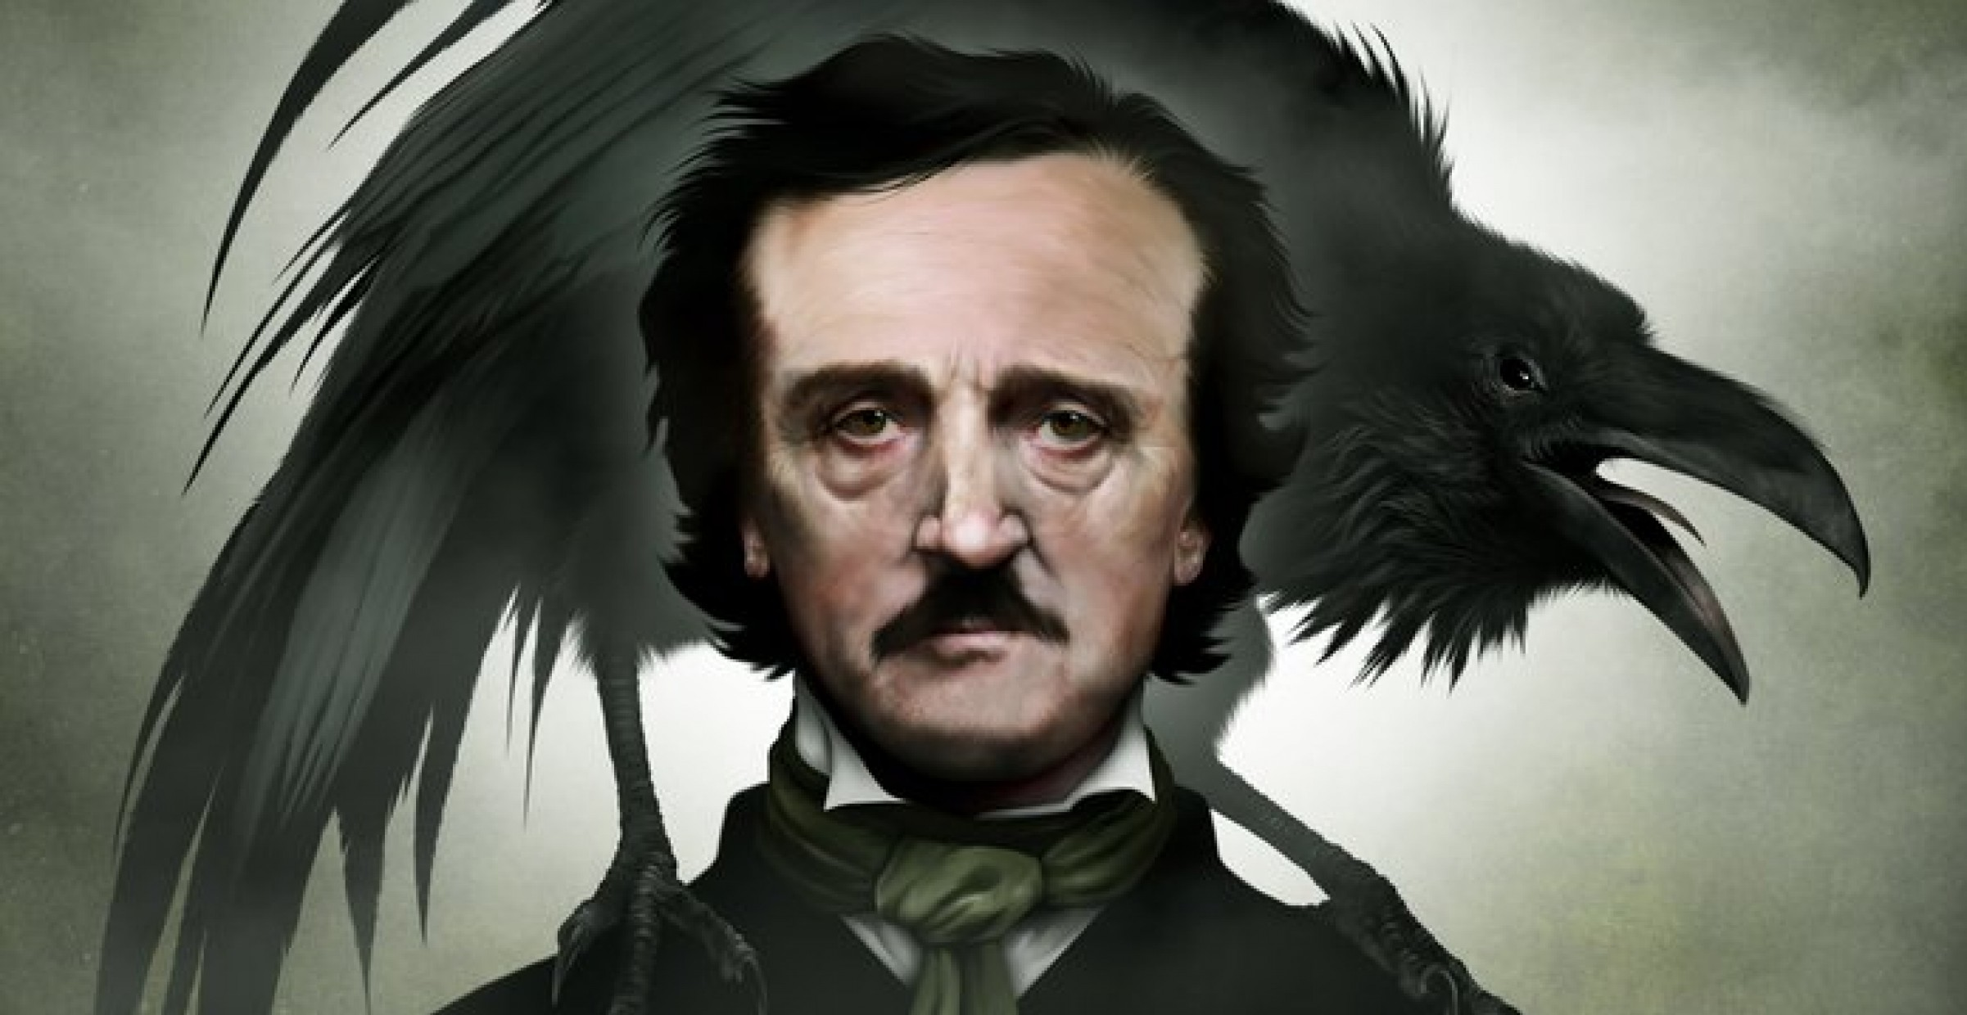
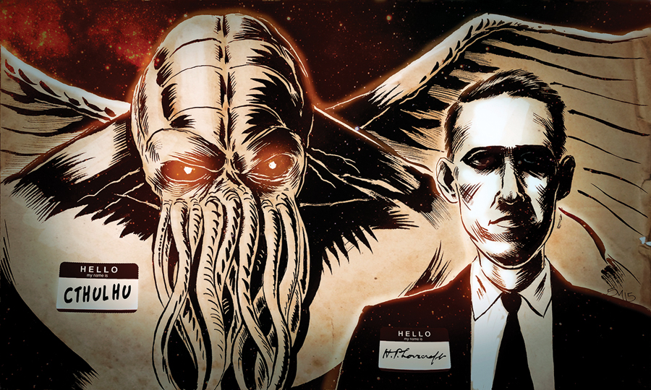
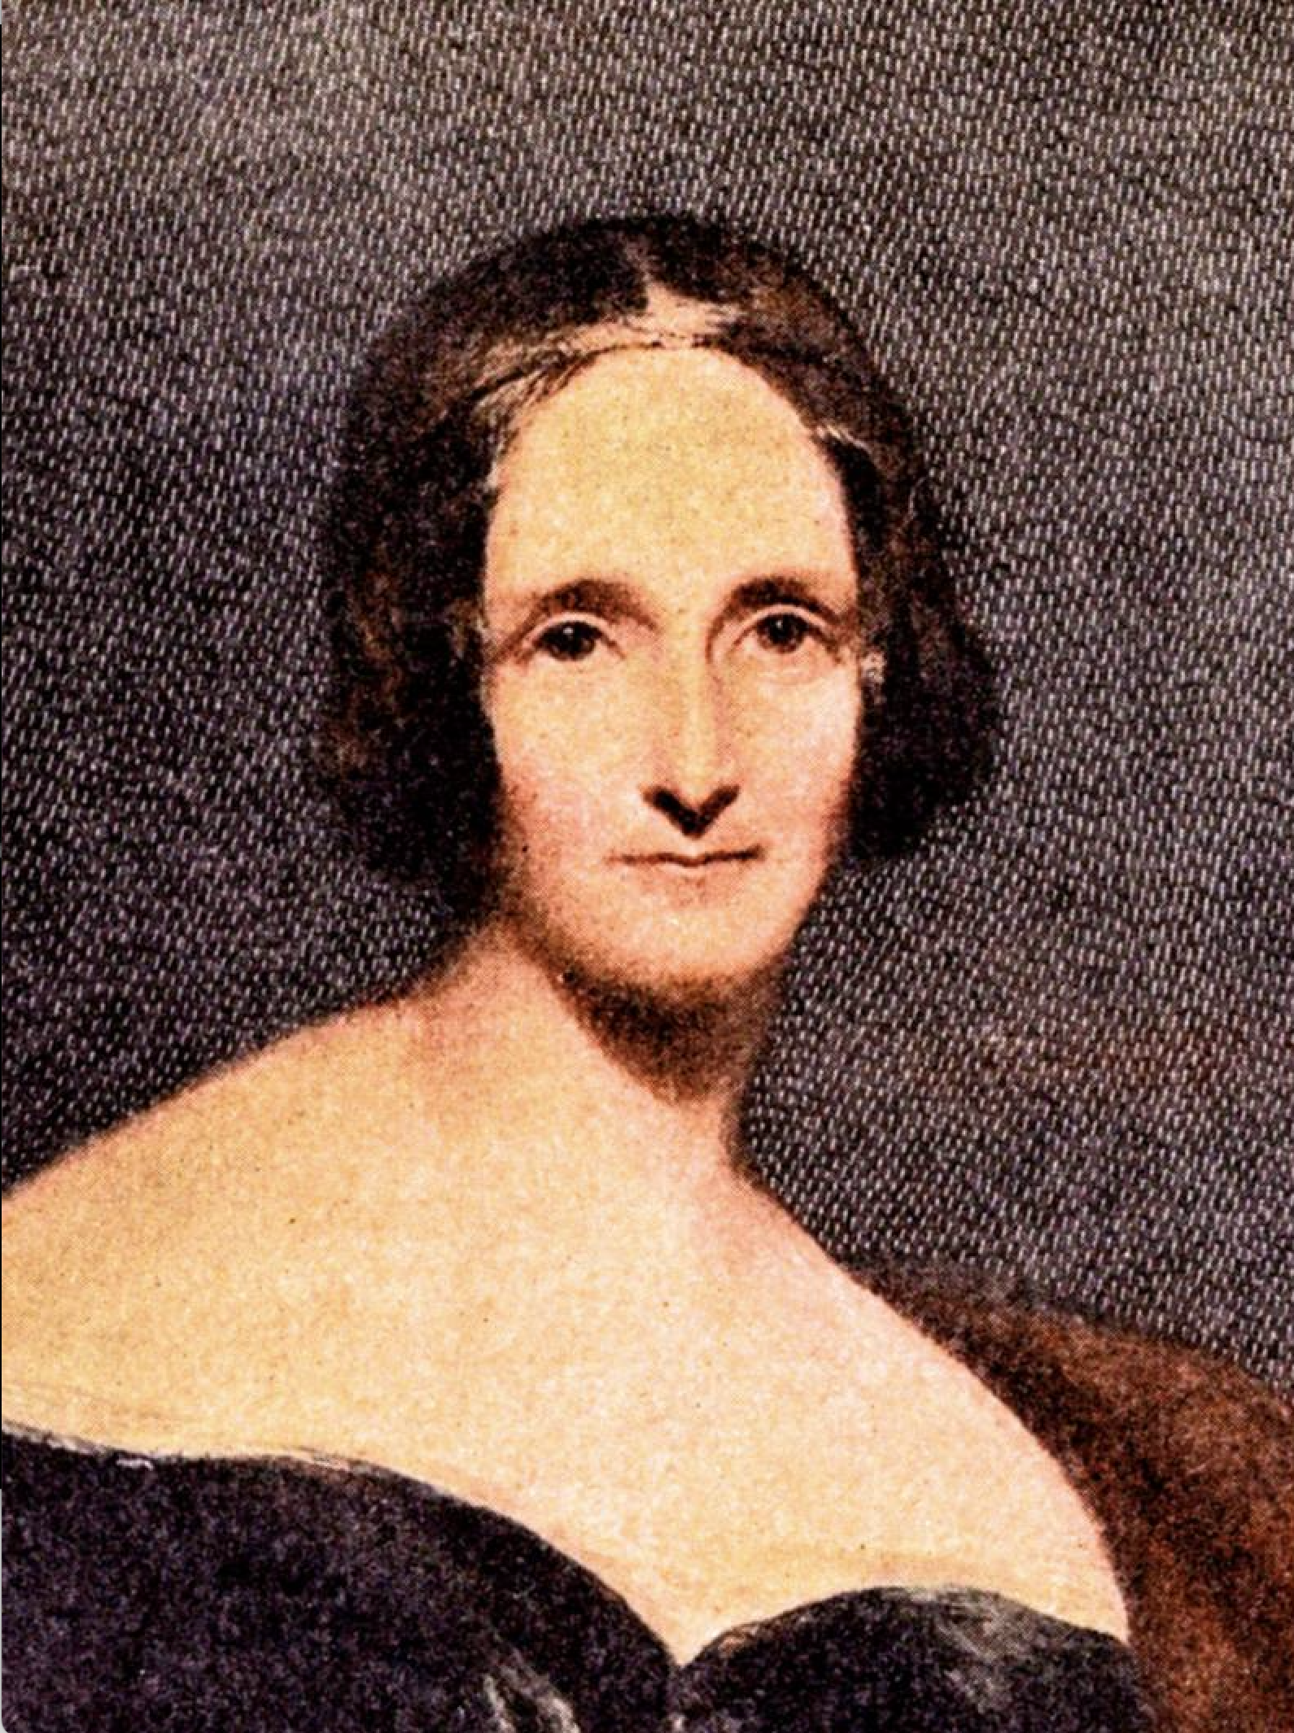
Our Authors
Edgar Allen Poe : American writer who wrote poetry and short stories that revolved around tales of mystery and the grisly and the grim. Arguably his most famous work is the poem - "The Raven" and he is also widely considered the pioneer of the genre of the detective fiction.
H.P. Lovecraft : Best known for authoring works of horror fiction, the stories that he is most celebrated for revolve around the fictional mythology of the infamous creature "Cthulhu" - a hybrid chimera mix of Octopus head and humanoid body with wings on the back.
Mary Wollstonecraft Shelley : Novelist, dramatist, travel-writer, biographer. She is most celebrated for the classic tale of Frankenstein where the scientist Frankenstein a.k.a "The Modern Prometheus" creates the Monster that comes to be associated with his name.

Slide 5
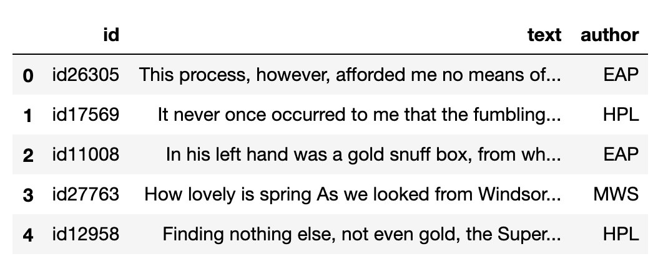
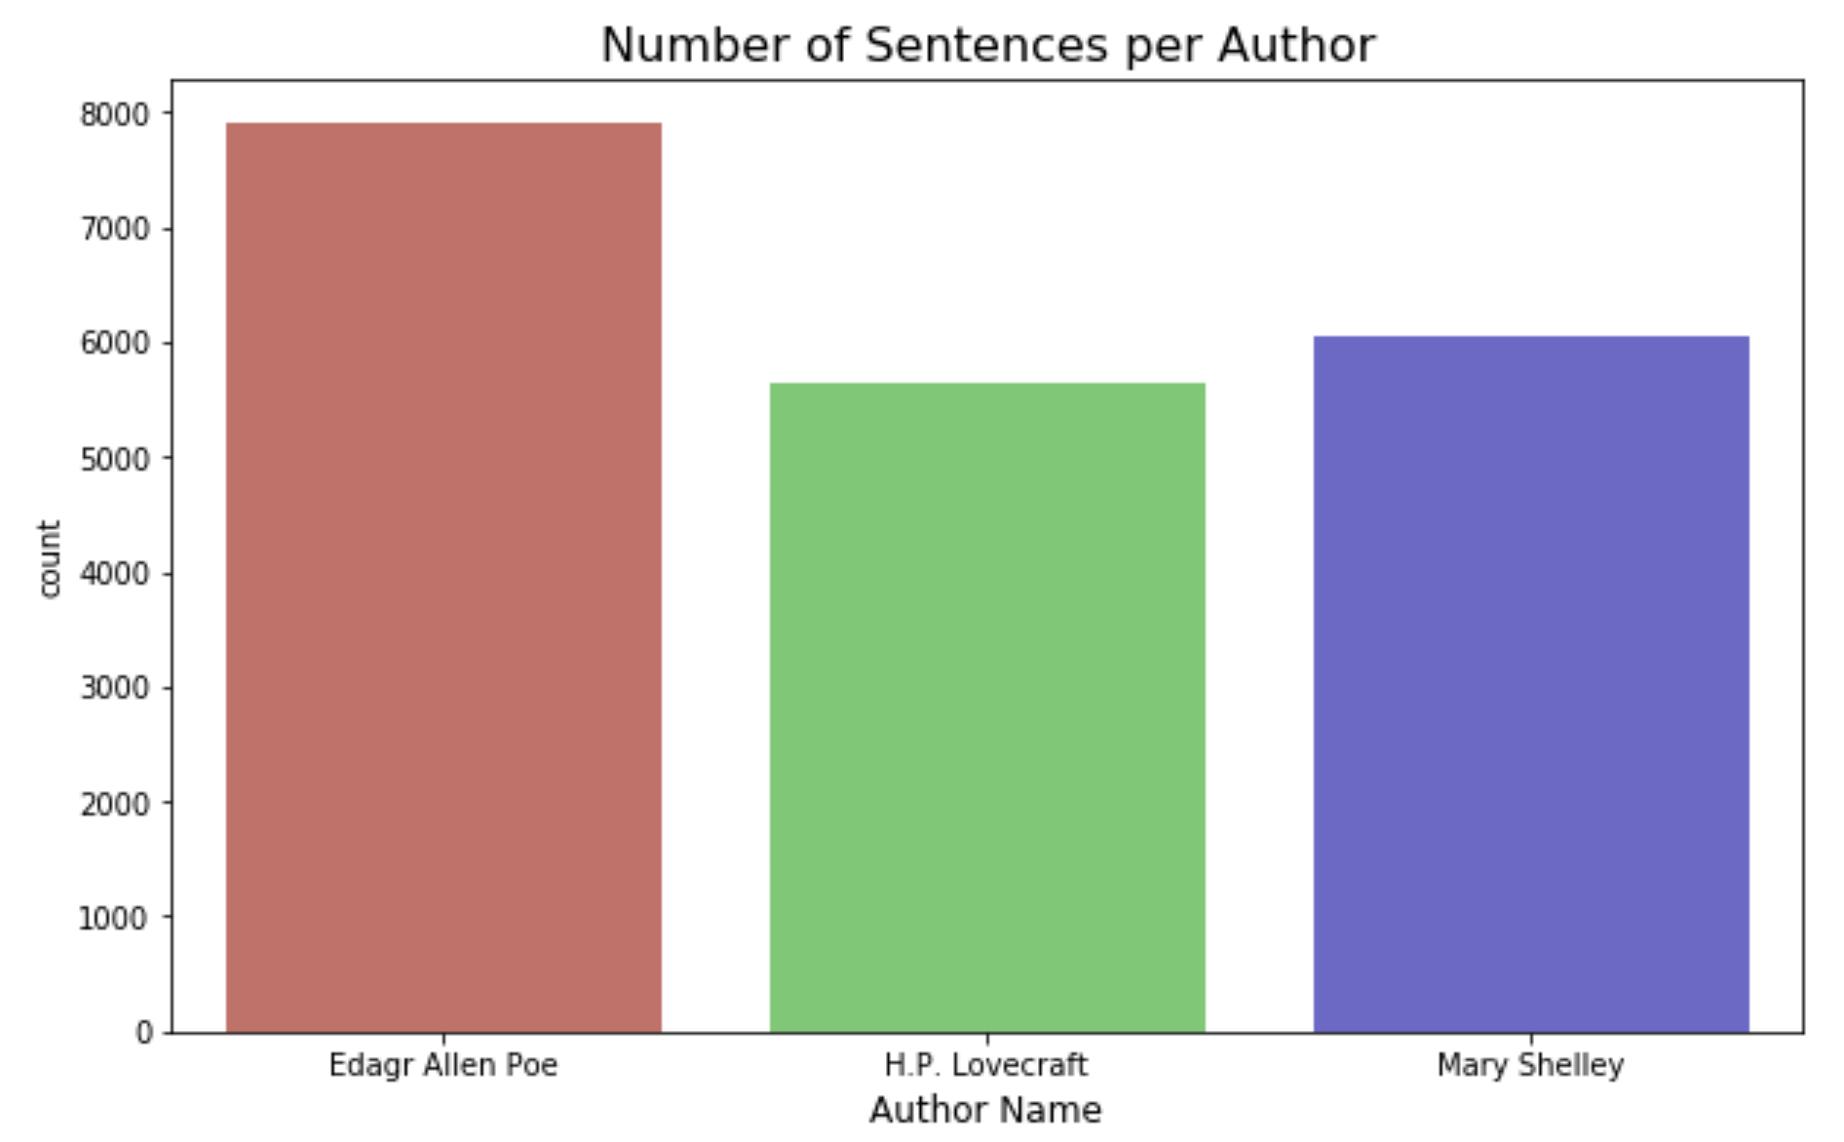
Visualizing data
Author statistic :
EAP – 7900 (40%)
MWS – 6044 (31%)
HPL – 5635 (29%)

Slide 6
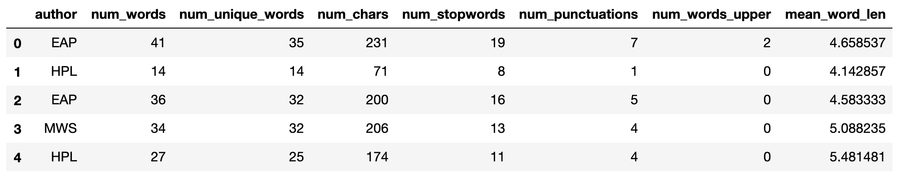
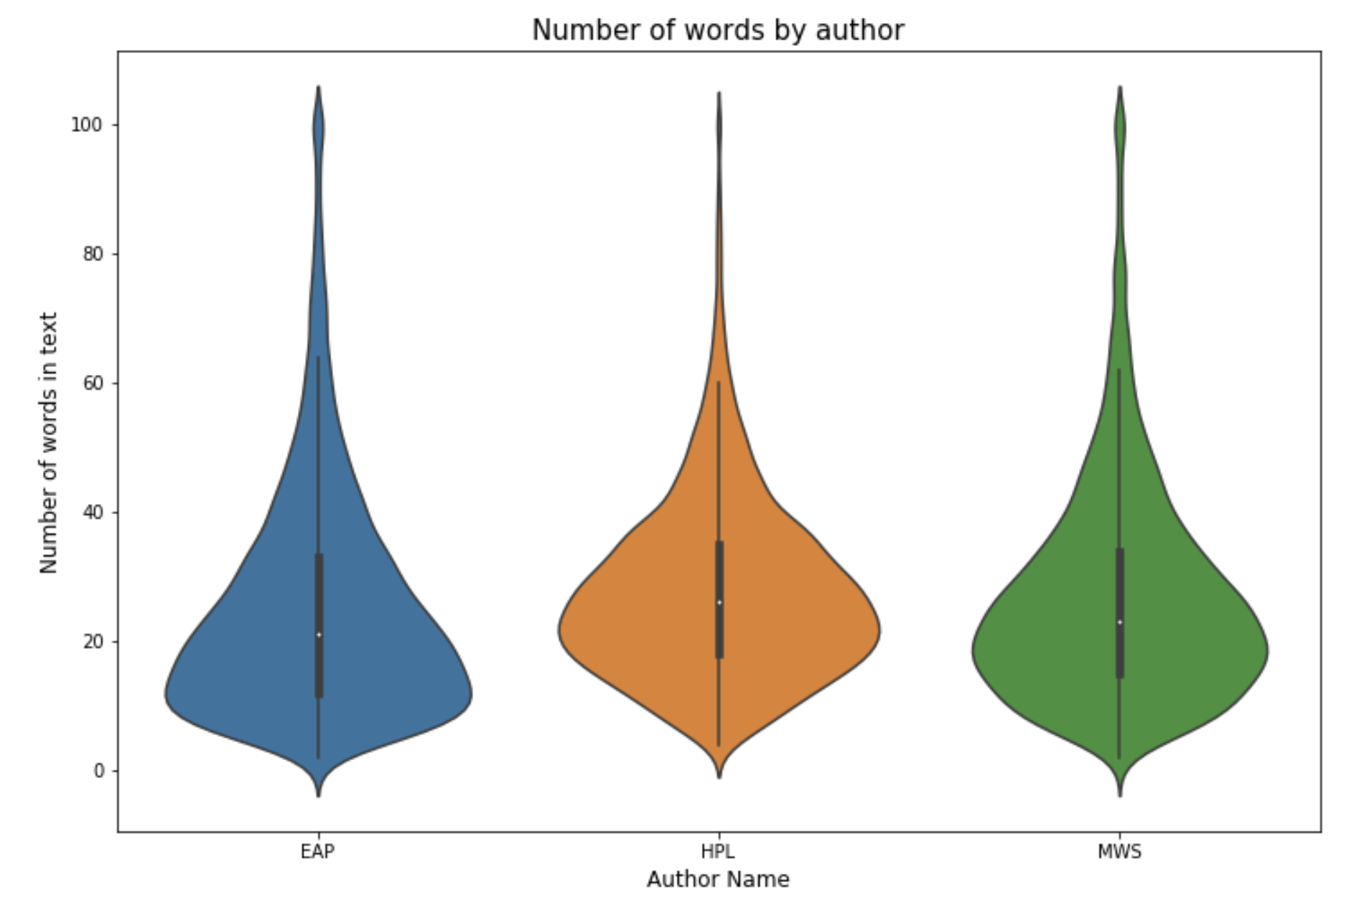
Visualizing data (cont’d)
Numerical stats

Slide 7
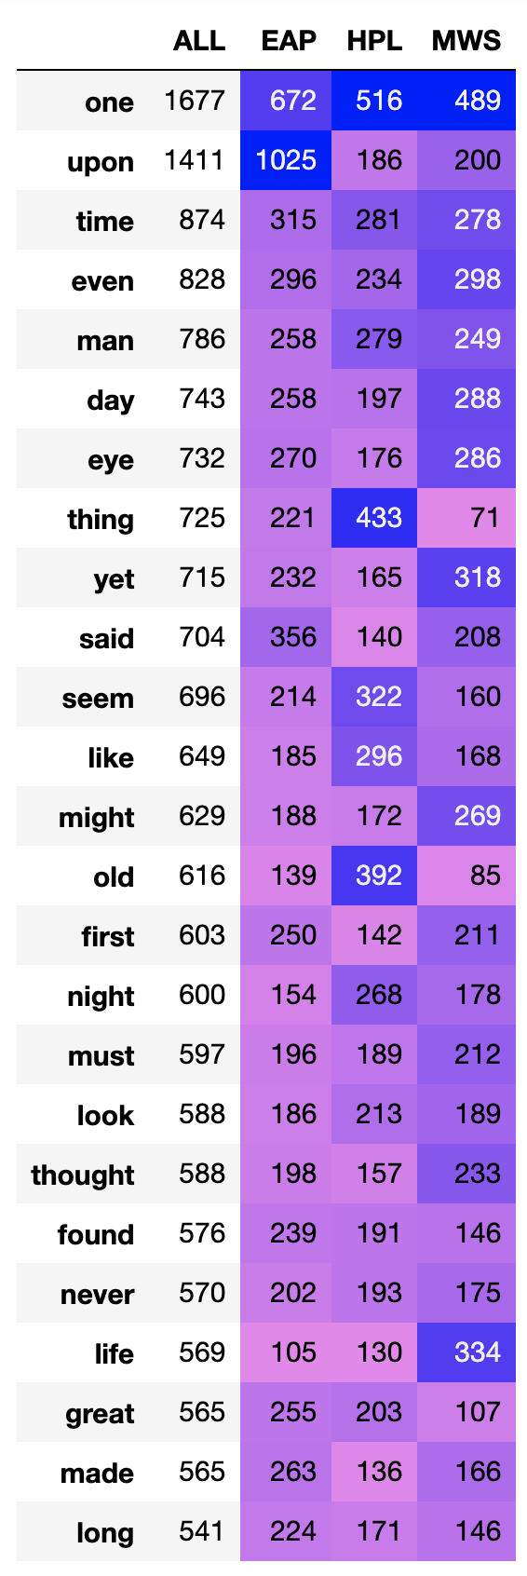
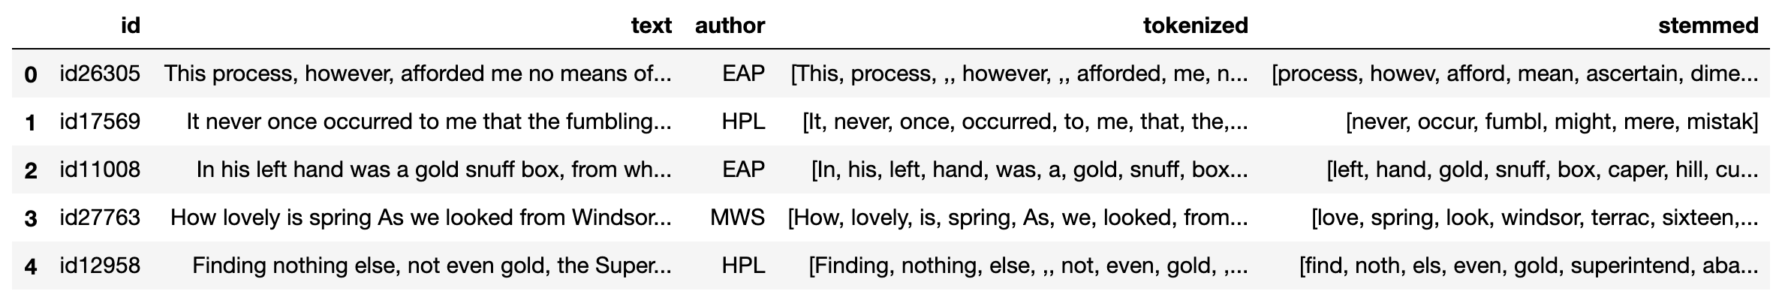
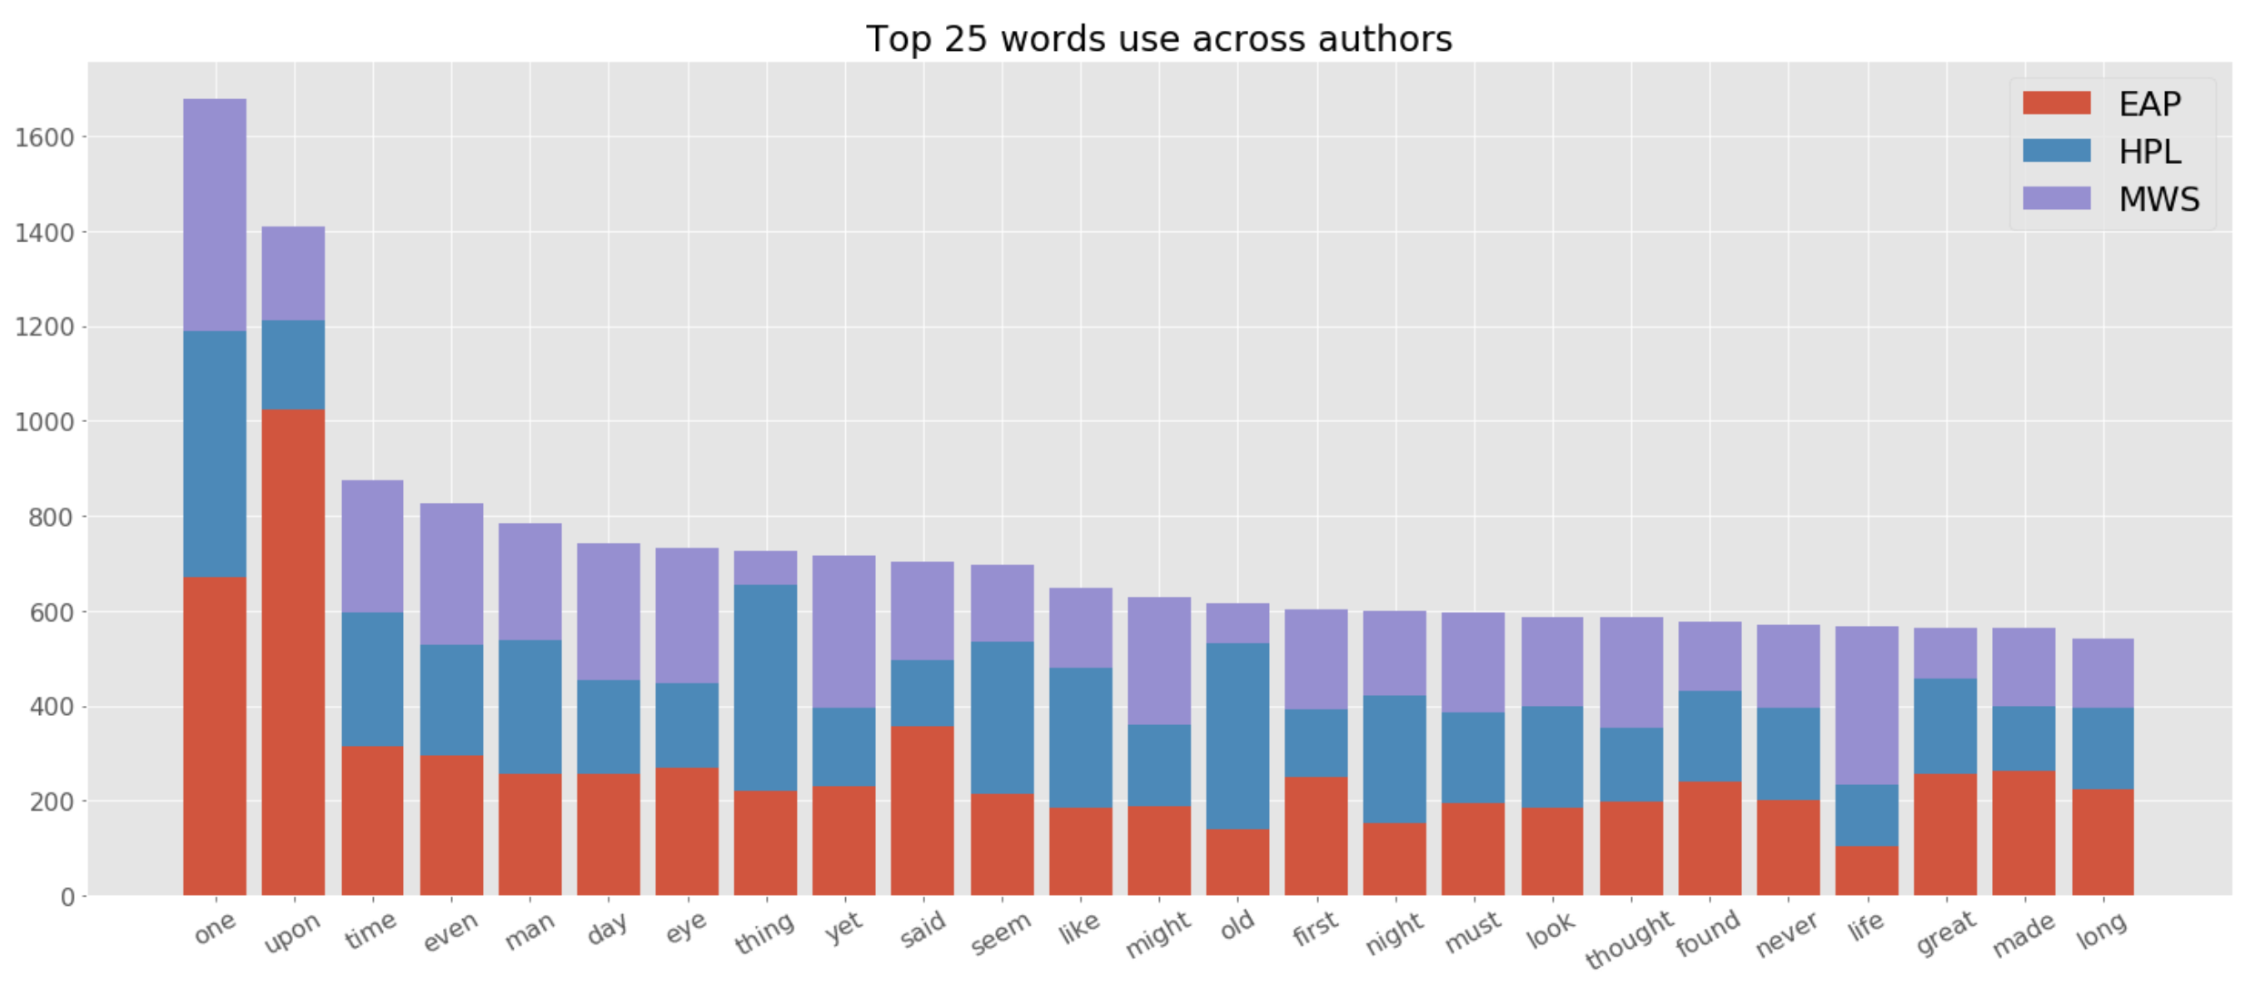
Visualizing data (cont’d)
Common Words

Slide 8
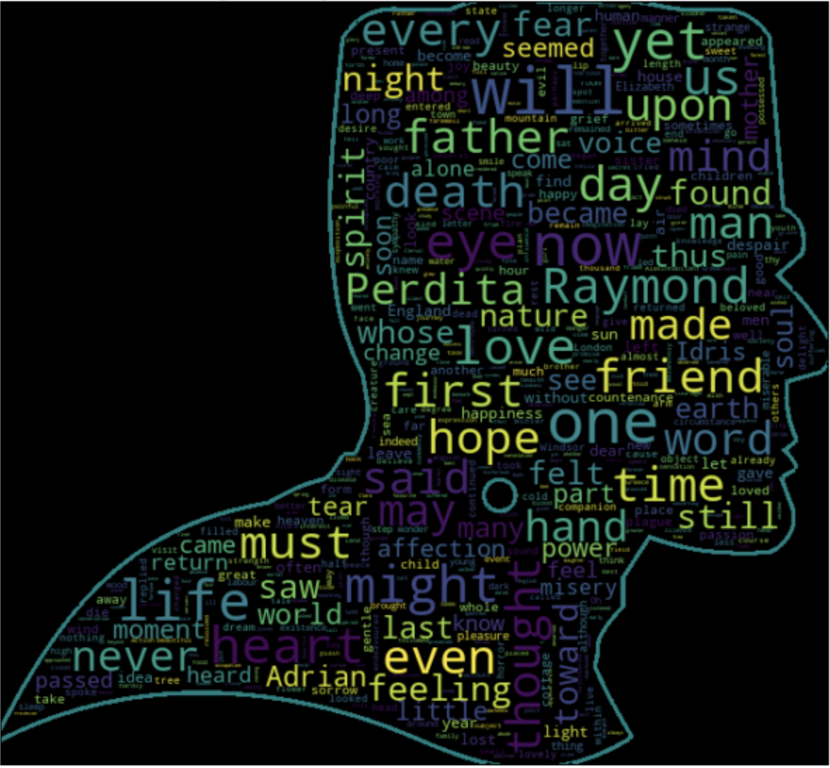
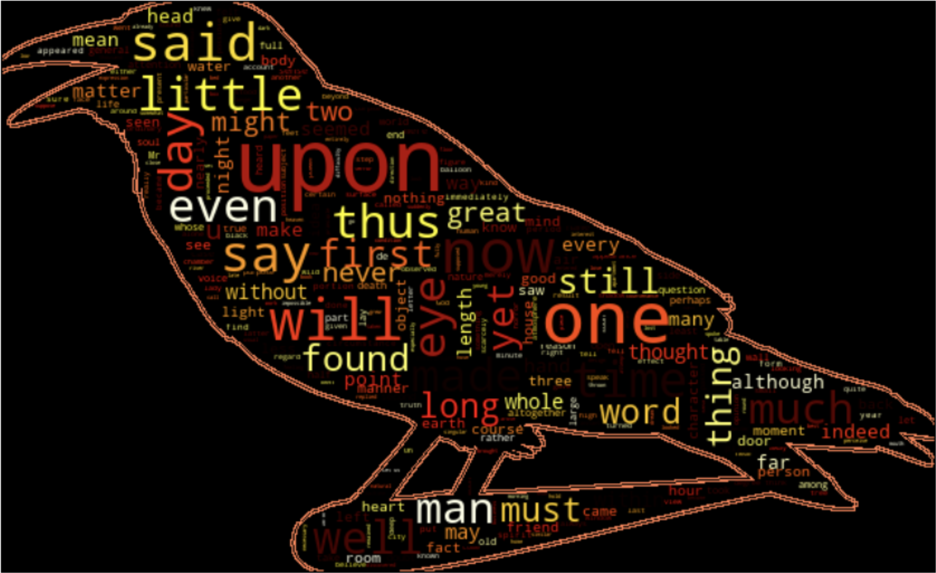
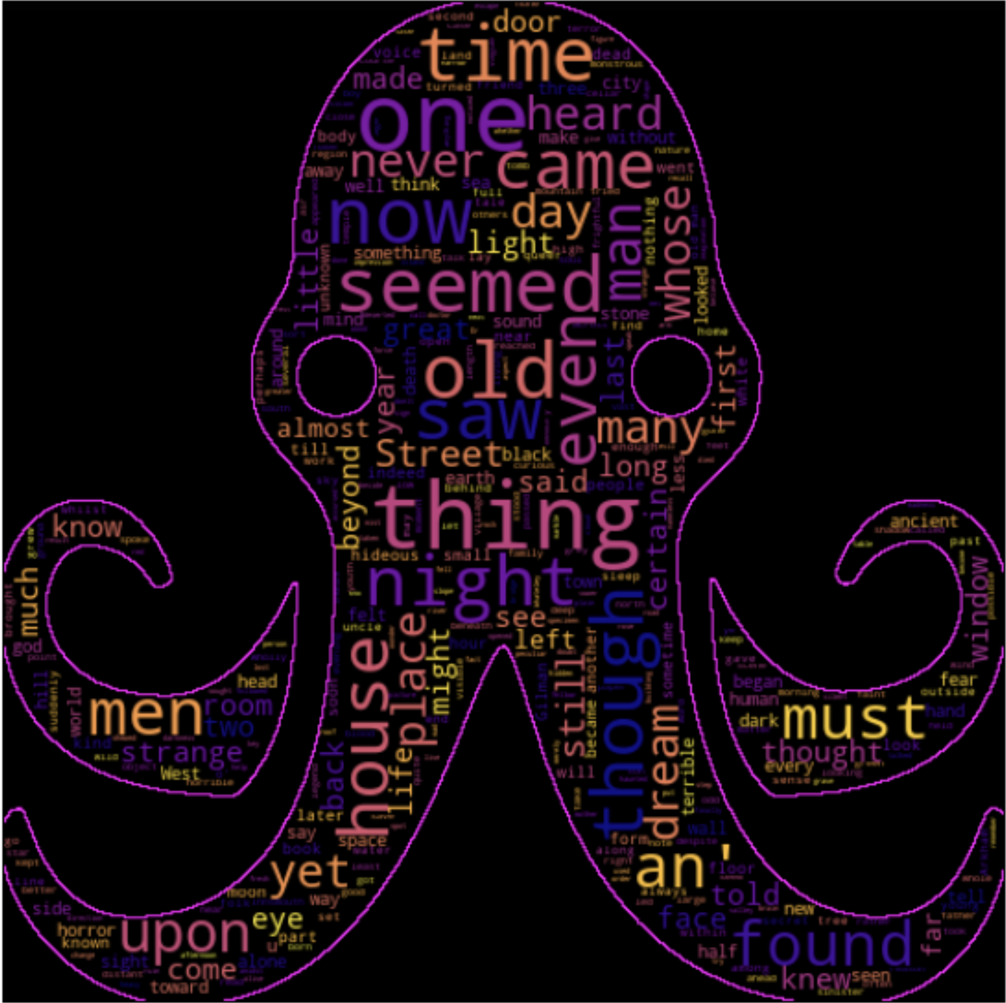
Wordcloud
HPL
EAP
MWS

Slide 9
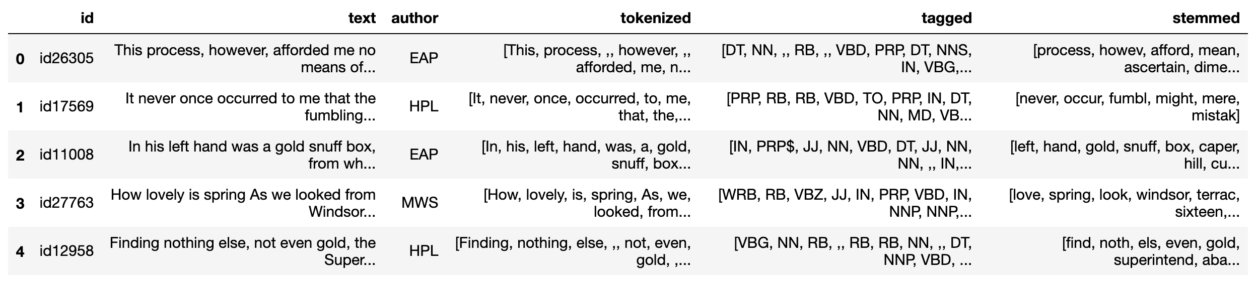
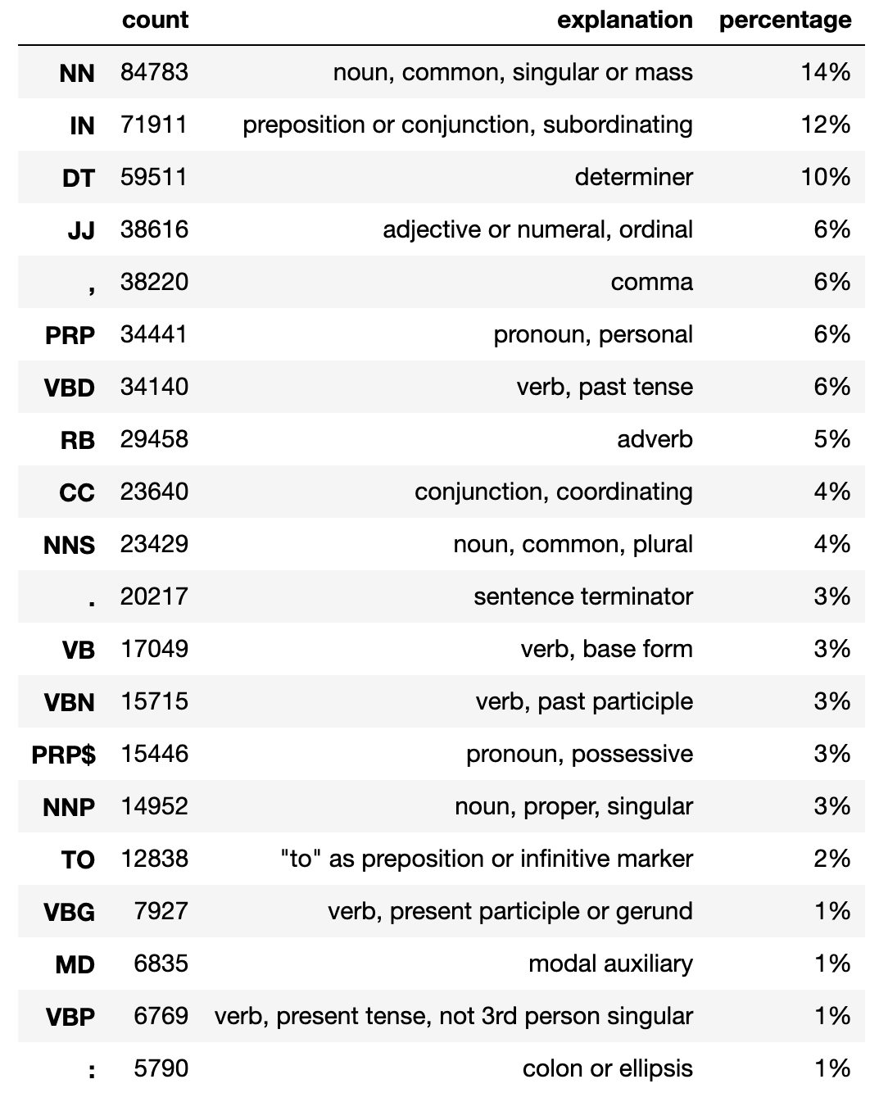
Processed text
Tokenizing, lemmatizing, stemming, removing stop words and punctuation, tagging parts of speech

Slide 10
Preprocessing & Modeling
Data:
Randomly split : 80% for Training and 20% for Testing
Numerical variables were scaled
Categorical variables were encoded
Selected Models:
Logistic Regression
K Nearest Neighbors Classifier
Random Forest Classifier
Gradient Boosting Classifier
Multinomial NB

Slide 11
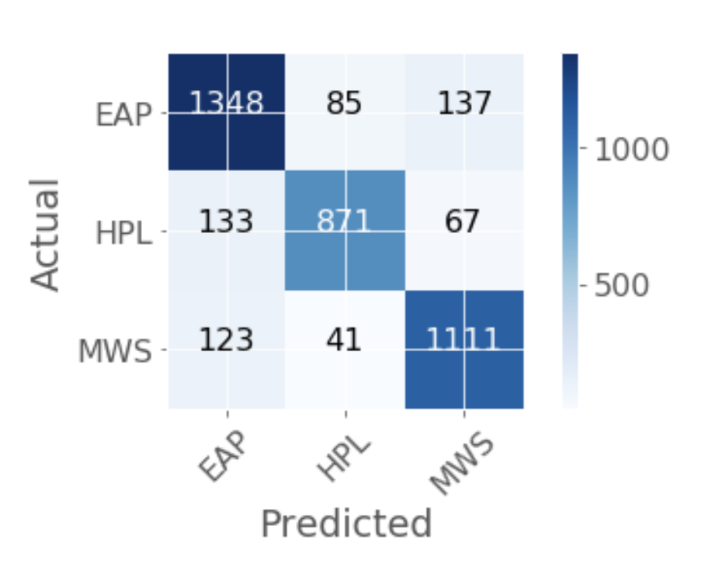
Results
The winner is Multinomial NB with an 85% accuracy
3916 total excerpt:
EAP: 1604 (1348)
HPL: 997 (871)
MS: 1317 (1111)

Slide 12
Conclusions

Slide 13
Limitations and Next Steps
Anybody interested in an enhanced literature search tool to find the (most likely) author of a preferred piece, as well as other writers with similar literary style
Can do a sentiment analysis; gender analysis; usage of stopwords, unique words, punctuations etc.

Slide 14
Questions?

Slide 15
Thank you!

Slide 16
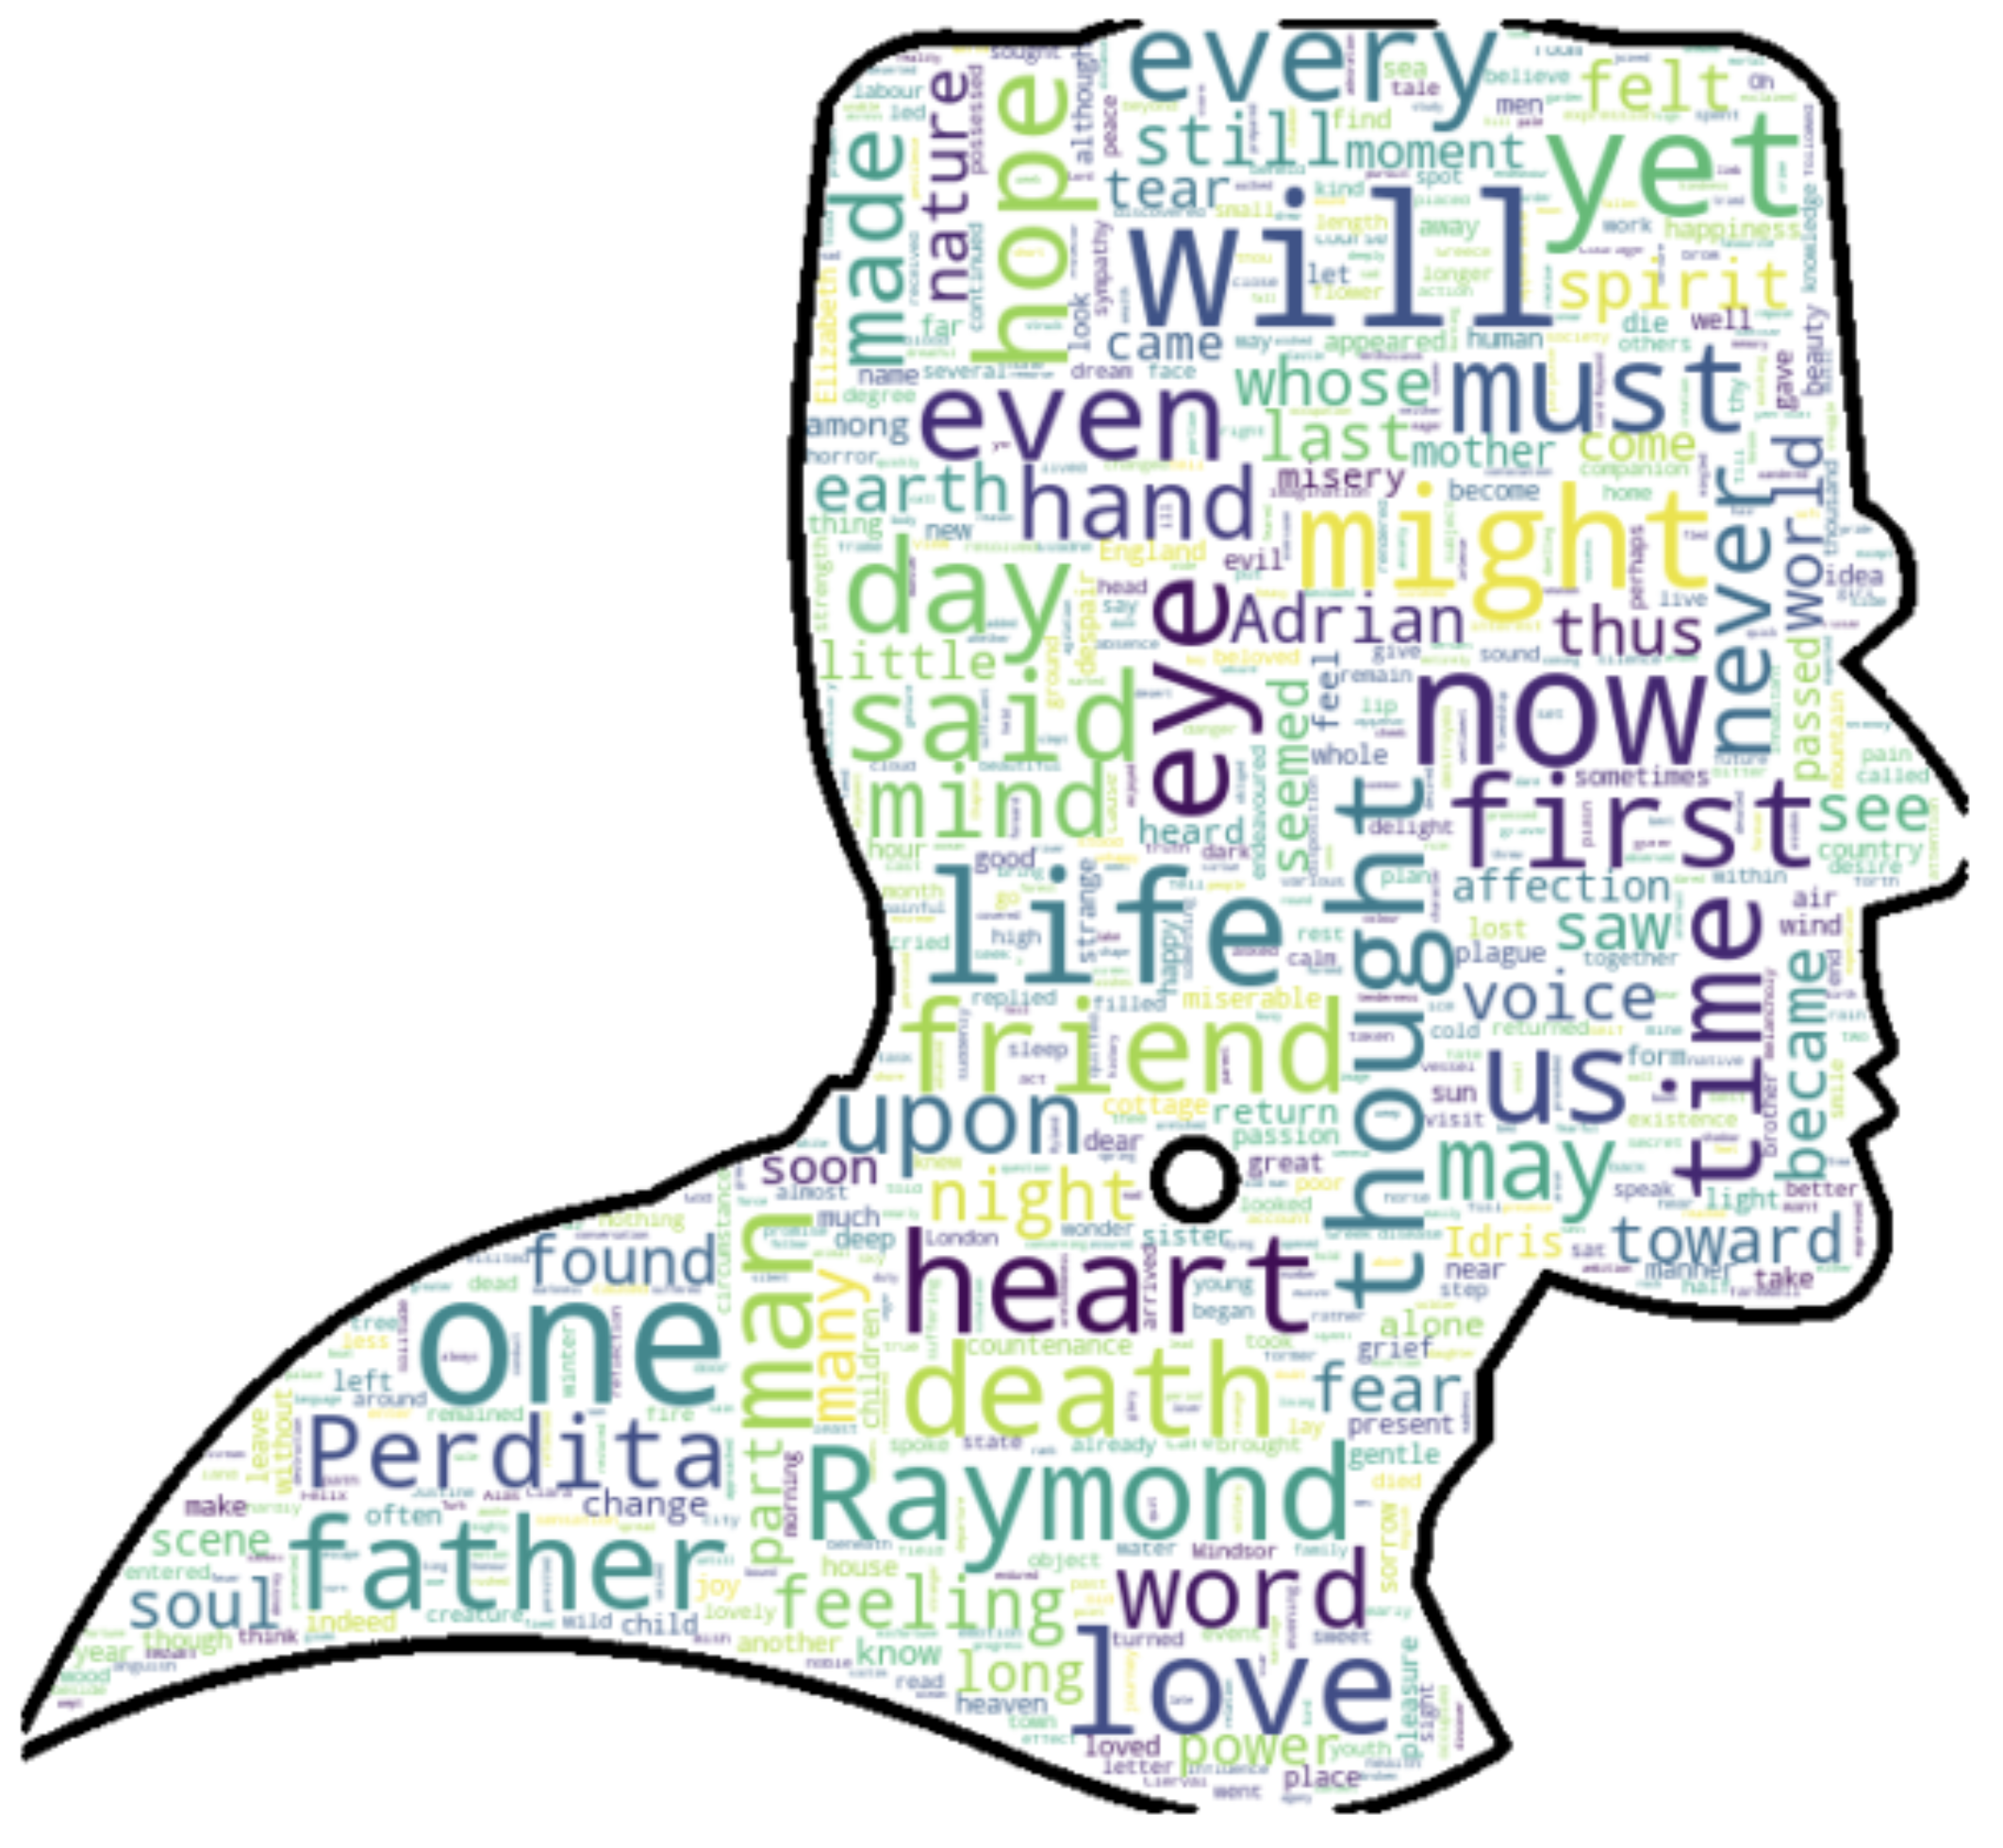
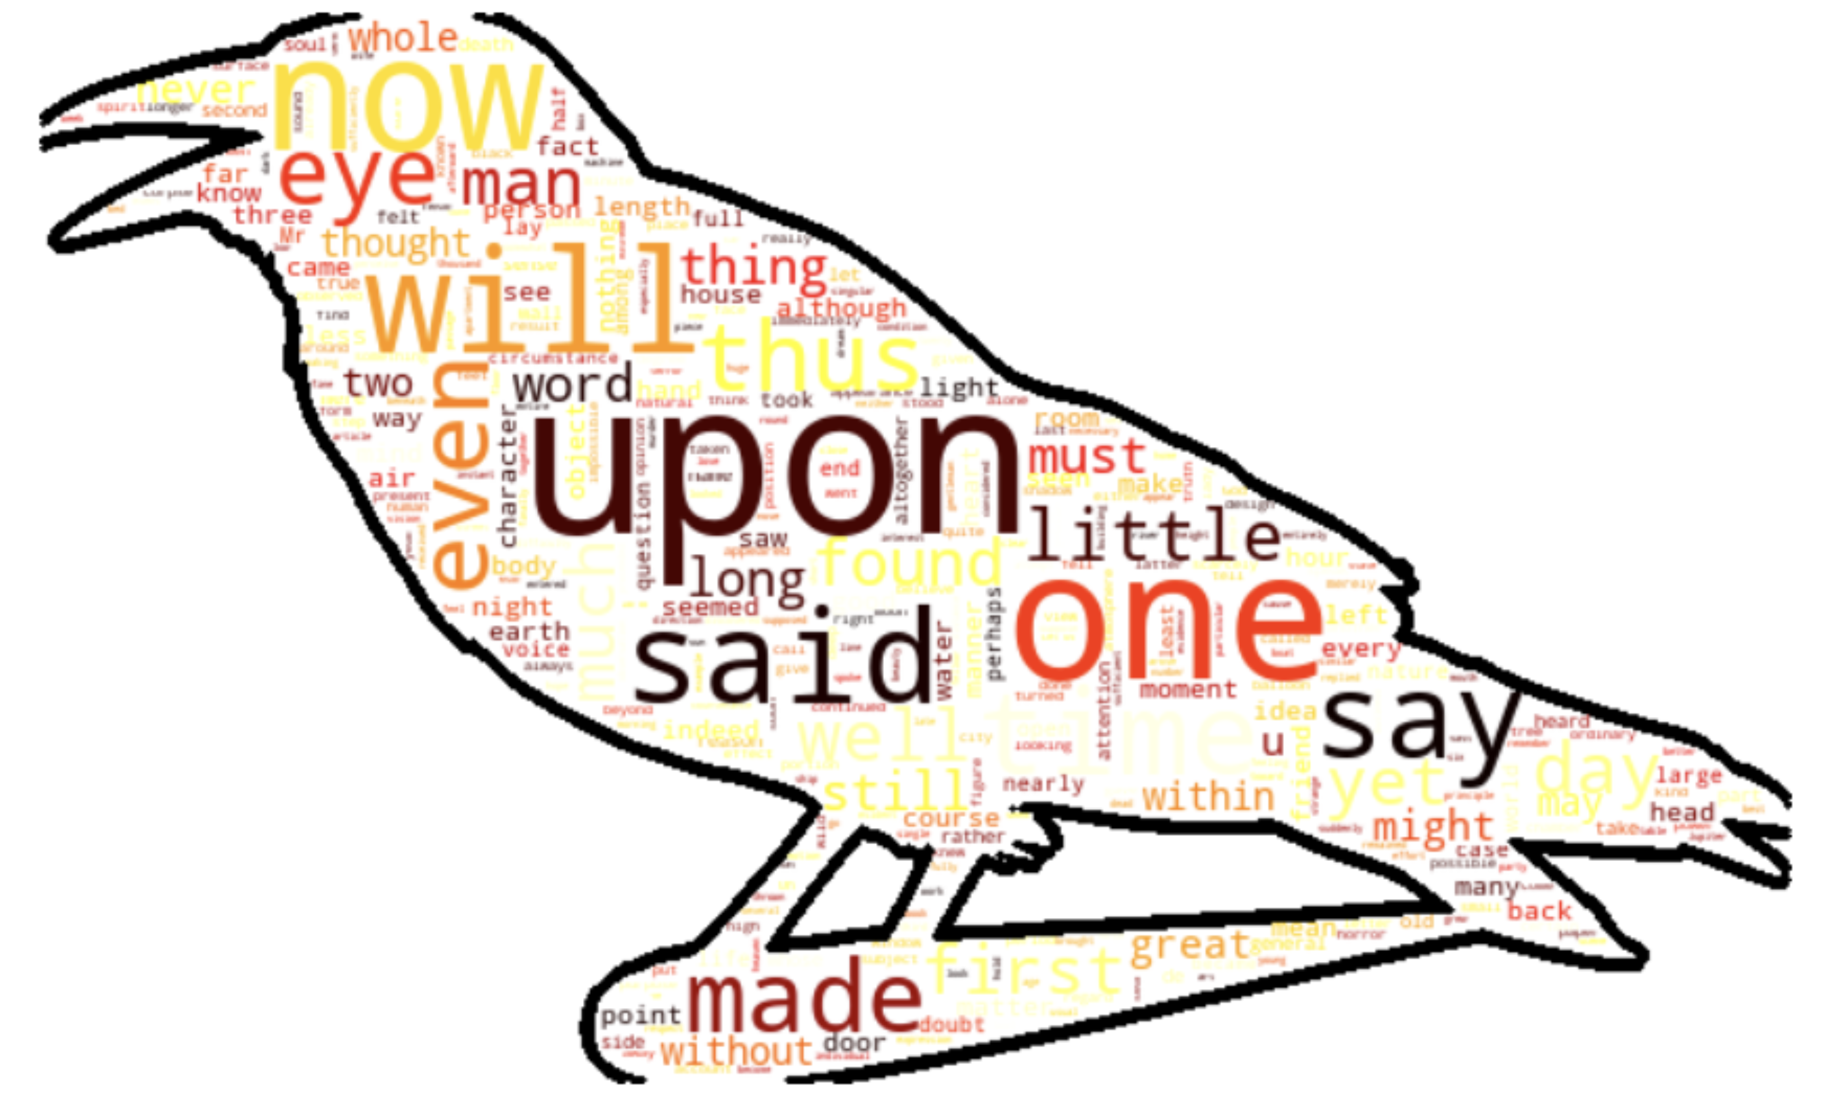
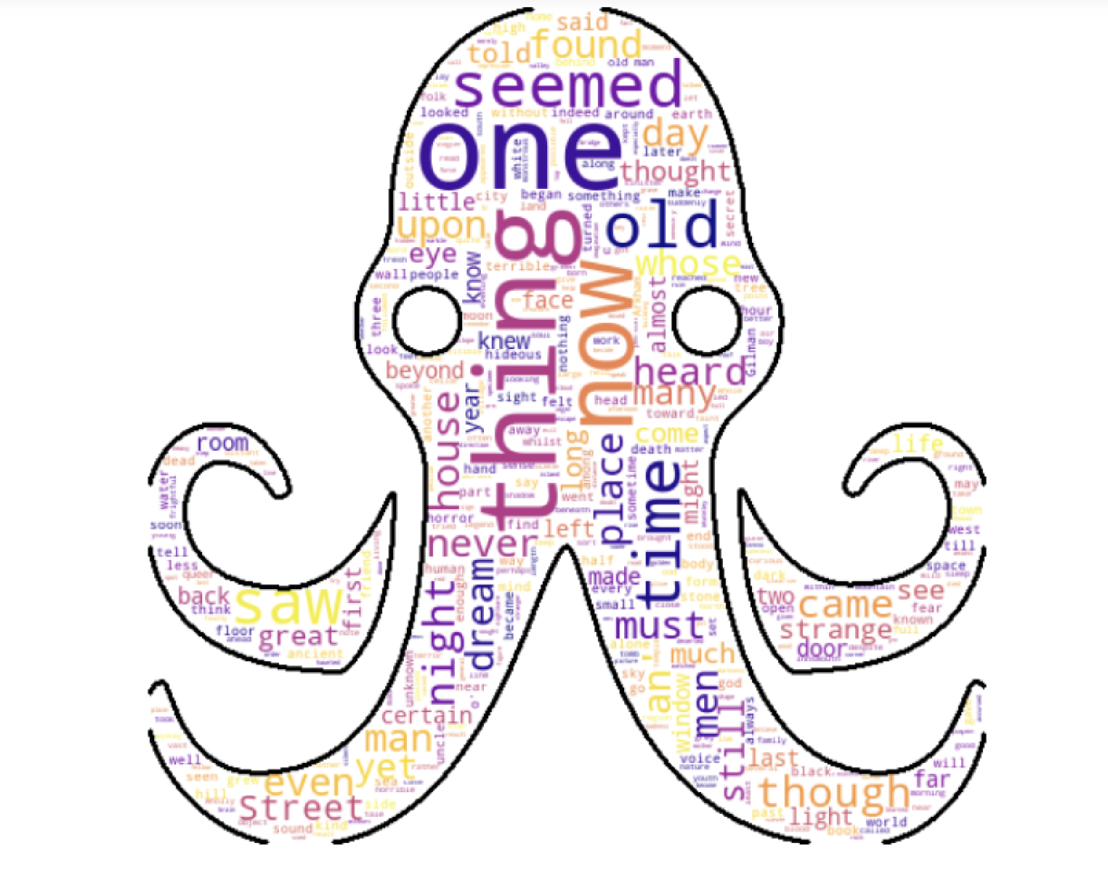
Wordcloud

Slide 17
Our Authors
Edgar Allen Poe : American writer who wrote poetry and short stories that revolved around tales of mystery and the grisly and the grim. Arguably his most famous work is the poem - "The Raven" and he is also widely considered the pioneer of the genre of the detective fiction.
H.P. Lovecraft : Best known for authoring works of horror fiction, the stories that he is most celebrated for revolve around the fictional mythology of the infamous creature "Cthulhu" - a hybrid chimera mix of Octopus head and humanoid body with wings on the back.
Mary Shelley : Novelist, dramatist, travel-writer, biographer. She is most celebrated for the classic tale of Frankenstein where the scientist Frankenstein a.k.a "The Modern Prometheus" creates the Monster that comes to be associated with his name.

Slide 18
Credentials

